Slide 1
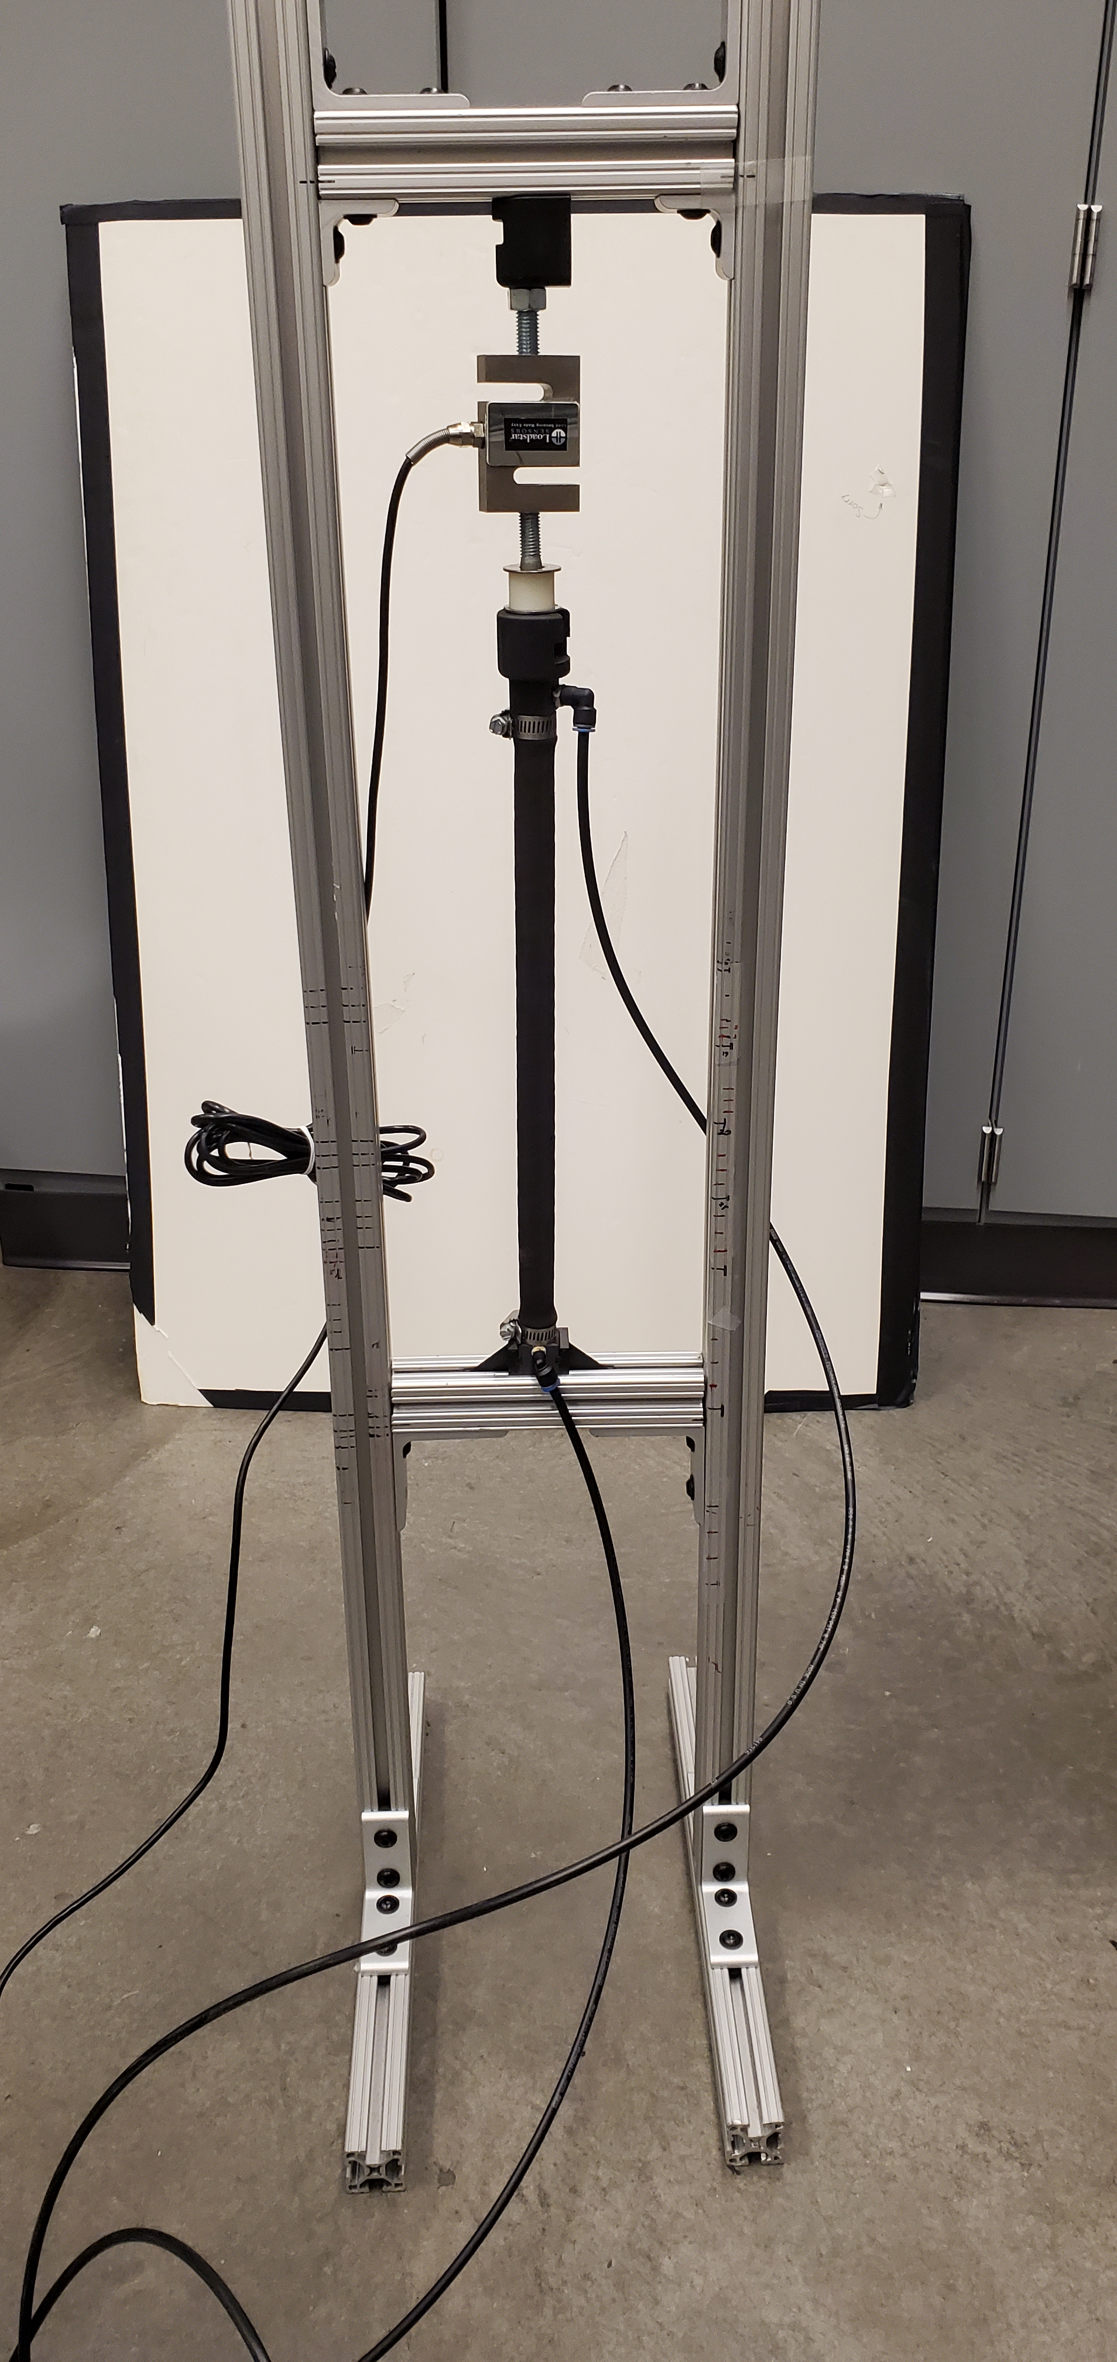
Test Frame
Load Cell
End Cap
BPA length
Hose Clamp
Air
Return
Air Supply

